Slide 1
Voluntary Codes and Standards
When Technical Standards Meet Administrative Law
Emily S. Bremer
Notre Dame Law School
www.pennreg.org/codes-standards
This material was developed under the auspices of the Penn Program on Regulation using federal funds under awards 70NANB15H343 and 70NANB15H344 from the National Institute of Standards and Technology (NIST), U.S. Department of Commerce. Any statements, findings, conclusions, and recommendations are those of the author and do not necessarily reflect the views of the Penn Program on Regulation, the University of Pennsylvania, NIST, or the U.S. Department of Commerce.

Slide 2
What is Incorporation by Reference?
An agency incorporates by reference when it publishes a final rule that identifies and adopts private standards or other materials that can only be found elsewhere.
Normally, Federal Register publication of the contents of an agency rule is required.
Consequences for non-publication: Can’t enforce the rule.
But Freedom of Information Act permits agencies to incorporate by reference materials “reasonably available” elsewhere.
If properly incorporated, these materials are “deemed published.”
Thus, materials that never appear in the Federal Register can nevertheless be properly considered part of a legally binding rule.

Slide 3
Examples of Incorporation by Reference
Federal Aviation Administration incorporating flight maps
Environmental Protection Agency incorporating state implementation plans into federal air pollution rules.
National Highway Traffic Safety Administration incorporating the Society for Automotive Engineers’ standards for headlamps
Federal Communications Commission incorporating Consumer Electronics Association’s standards for television remote controls

Slide 4
Why Agencies Incorporate Private Standards: Legal Reasons
Some agencies’ statutes require following private standards
Example: 15 U.S.C. 2089 states that “the [Consumer Product Safety] Commission shall publish in the Federal Register as a mandatory consumer product safety standard the American National Standard for Four Wheel All-Terrain Vehicles Equipment Configuration, and Performance Requirements developed by the Specialty Vehicle Institute of America (American National Standard ANSI/SVIA -1-2007)”
National Technology Transfer and Advancement Act
Except when “inconsistent with applicable law or otherwise impractical “ all Federal agencies and departments shall use technical standards that are developed or adopted by voluntary consensus standards bodies, using such technical standards as a means to carry out policy objectives or activities determined by the agencies and departments

Slide 5
Why Agencies Incorporate Private Standards: Policy Reasons
Saves agencies time and expense
Builds on industry expertise
Avoids duplication/promotes uniformity
May be updated more frequently

Slide 6
The Public Access Problem
When private standards become incorporated by reference into public regulations, the terms of those standards are not published in the Federal Register or the Code of Federal Regulations.
How easy is it for the public to know what these incorporated standards say?
The public access problem is complicated by the fact that private standards are often copyrighted.

Slide 7
Copyright
Governmental use is not necessary fair use. See, e.g., 1999 OLC Opinion.
Private codes adopted by law may merge with the law and become part of public domain. Veeck v. Southern Bldg. Code Congress Int'l, Inc., 293 F.3d 791 (5th Cir. 2002) (en banc).
But Veeck expressly excluded standards incorporated by reference into law, which retain copyright even after incorporation
Notes:
OLC Opinion: https://www.justice.gov/sites/default/files/olc/opinions/1999/04/31/op-olc-v023-p0087.pdf.

Slide 8
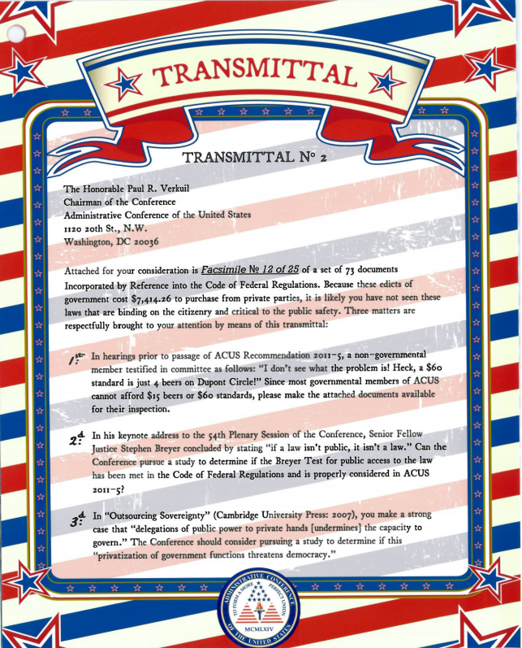
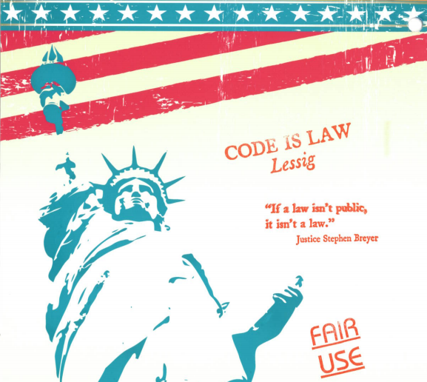
Public.Resource.org’s Box of Standards Campaign (2012)
Notes:
The picture in the top left is of Carl Malamud standing next to the packed boxes of standards he sent to a handful of administrative agencies and SSOs. The image on the right is one of the transmittal letters, in this case the one included in the box addressed to ACUS. The image on the bottom left is of some of the pictures and stamps included in and on the boxes. These images come from the resources available through Boing Boing’s story on the subject:” http://boingboing.net/2012/03/19/liberating-americas-secret.html

Slide 9
Public Access: A “Wicked” Question?
Policy: Should the full text of standards incorporated by reference in federal regulations be available for free online?
Law: Does the law require free online availability?
Should we separate these questions? Why or why not?
Notes:
John Cooney, the then-chair of the ACUS Committee on Administration and Management, which prepared Recommendation 2011-5, Incorporation by Reference, described the public access issue as a “wicked question” because each of the apparent answers appears to involve a significant cost to a valuable interest.

Slide 10
Incorporated Standards Must Be “Reasonably Available”
“Except to the extent that a person has actual and timely notice of the terms thereof, a person may not in any manner be required to resort to, or be adversely affected by, a matter required to be published in the Federal Register and not so published. For the purpose of this paragraph, matter reasonably available to the class of persons affected thereby is deemed published in the Federal Register when incorporated by reference therein with the approval of the Director of the Federal Register.”
5 U.S.C. § 552(a)(1)

Slide 11
Interpreting 5 U.S.C. § 552(a)(1)
What does “reasonably available” mean?
What tools do you use—in what order—to decide?
Does it mean free online availability?
What agency is tasked with responsibility for interpreting this statutory provision?
If free online availability is not required, is that the end of the matter?

Slide 12
A Multidimensional Problem
Are there are other legal requirements relevant to the addressing the public access question? If so, what are they?
Note that other such requirements may complicate:
Question of which agency is responsible for ensuring “reasonably available.”
Range of workable solutions for ensuring “reasonably availability.”
Does Congress need to act to address these issues? If so, how?

Slide 13
Federal Standards Policy
OMB Circular A-119—first issued in late 1970s; partially codified by National Technology Transfer and Advancement Act of 1995 (“Tech Transfer Act”).
What guidance, if any, does the Circular provide?
For the Office of the Federal Register?
For agencies that incorporate standards?
Does the NTTAA shed any light?
Notes:
In the Circular, consider the relevance of the definitions of standards (Section 5), the discussion of “use” (Section 6), and the provisions related to agency participation in VCS bodies (Section 7). These seem more relevant for incorporating agencies, but may also change the calculus for OFR.

Slide 14
State of Play
ACUS Recommendation 2011-5.
Short-lived, narrow statutory provision imposed on Pipeline and Hazardous Materials Safety Administration in 2012.
OFR revised its regulations in 2014.
OMB revised Circular A-119 in January 2016—full text not published in Federal Register, but noticed there and posted online.
Copyright: Appeal pending in D.C. Circuit as of 2017.
Notes:
New Circular: https://www.whitehouse.gov/sites/default/files/omb/inforeg/revised_circular_a-119_as_of_1_22.pdf

