Slide 1
Voluntary Codes and Standards
Private Standards and the Benzene Case
Cary Coglianese
University of Pennsylvania
Gabriel Scheffler
University of Miami School of Law
www.pennreg.org/codes-standards
This material was developed under the auspices of the Penn Program on Regulation using federal funds under awards 70NANB15H343 and 70NANB15H344 from the National Institute of Standards and Technology (NIST), U.S. Department of Commerce. Any statements, findings, conclusions, and recommendations are those of the individual authors and do not necessarily reflect the views of the Penn Program on Regulation, the University of Pennsylvania, NIST, or the U.S. Department of Commerce.

Slide 2
Purposes of this Lesson
Understand historical aspects of the Benzene Case mentioned in the Supreme Court’s opinion but not explained in the casebook
Use this history as a window into learning about private standards
Provide a basis for reflection on the proper role for private standards in addressing public regulatory problems

Slide 3
Government Actions in the Benzene Case
1970 Congress passes the Occupational Safety and Health Act
1971 OSHA adopts a 10 ppm permissible exposure limit for benzene in workplace air
Based on an earlier “private standard”
Adopted by OSHA without notice and comment
1978 OSHA revises its 10 ppm permissible exposure limit for benzene, lowering it to 1 ppm
Based on government analysis and notice and comment
Industry files suit challenging the revised limit; eventually the case reaches the Supreme Court

Slide 4
Private Standards in the Benzene Case
“In 1969 the American National Standards Institute (ANSI) adopted a national consensus standard of 10 ppm … In 1971, after the Occupational Safety and Health Act was passed, the Secretary adopted this consensus standard as the federal standard, pursuant to 29 U.S.C. 655 (a).”
Indus. Union Dep't, AFL-CIO v. Am. Petroleum Inst., 448 U.S. 607, 617 (1980)

Slide 5
Private Standards in the Benzene Case
“The Secretary complied with the directive to choose the most protective standard by selecting the ANSI standard of 10 ppm, rather than the 25 ppm standard adopted by the American Conference of Government[al] Industrial Hygienists. 43 Fed.Reg. 5919 (1978).”
Indus. Union Dep't, AFL-CIO v. Am. Petroleum Inst., 448 U.S. 607, 617 (1980)

Slide 6
Questions Raised by the Court’s Historical Account
What is the American National Standards Institute (ANSI)?
What is the American Conference of Governmental Industrial Hygienists (ACGIH)?
What is a “national consensus standard?”

Slide 7
The American National Standards Institute (ANSI)
Private, non-profit organization that “oversees the creation, promulgation and use of thousands of norms and guidelines that directly impact businesses in nearly every sector”
Dates back to an organization founded in 1918
Today, ANSI does not establish any standards itself, but it serves as key accreditor of other private standards development organizations

Slide 8
ANSI’s Organizational History
1918 Establishment of the American Engineering Standards Committee (AESC)
1928 AESC reorganized and renamed the American Standards Association (ASA)
1966 ASA reorganized as the United States of America Standards Institute (USASI)
1969 USASI reorganized/renamed American National Standards Institute (ANSI)

Slide 9
The Basic Process of Private Standards Development
The process of standards development can vary from organization to organization
Generally, the process is committee- and consensus-based
Identify stakeholders and form a consensus body
Publish proposed standards for review
Consensus decision-making (usually not unanimity)
Appeals Process
ANSI has developed a set of “essential” procedural requirements designed to ensure “due process”
Must be followed to have an American National Standard

Slide 10
ANSI’s “Essential Requirements”
“Openness”
“Lack of dominance”
“Balance”
“Coordination and harmonization”
“Notification of standards development”
“Consideration of views and objections”
“Consensus vote”
“Appeals”
“Written procedures”
“Compliance with normative American National Standards policies and administrative procedures.”

Slide 11
Steps in Developing the 1969 “ANSI” Benzene Standard
Sept. 1969 USASI adopts the 10 ppm benzene standard
Committee formed under the auspices of the American Industrial Hygiene Association (AIHA)
Committee members came from AIHA, ACGIH, the American Petroleum Institute, medical and other professional societies, the insurance industry, and government agencies
Oct. 1969 USASI reorganized/renamed American National Standards Institute (ANSI)
The 10 ppm benzene standard became an “American National Standard.”

Slide 12
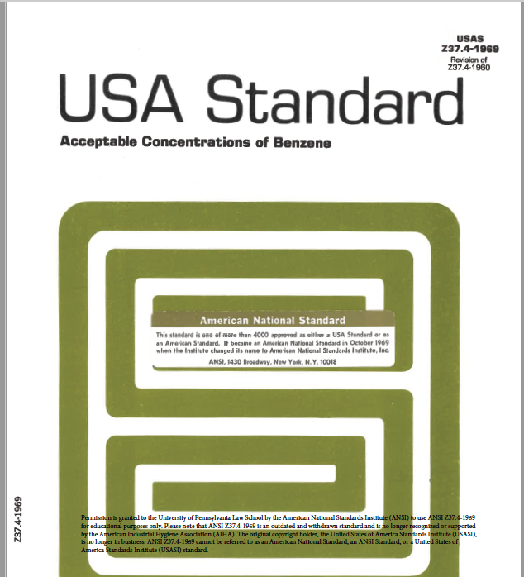
The 1969 “ANSI” Benzene Standard

Slide 13
The American Conference of Governmental Industrial Hygienists (ACGIH)
Private non-profit organization founded in 1938
ACGIH issues “threshold limit values” (TLV) for workplace exposures to chemicals.
Initially ACGIH had a less stringent benzene TLV (25 ppm) than what OSHA adopted in 1971, but it later lowered its TLV to 10 ppm in 1974.
In 1971, OSHA did adopt ACGIH TLVs for many other chemicals in same rulemaking.

Slide 14
OSHA’s Incorporation of the 1969 Benzene Standard
OSHA adopted the ”ANSI” standard in 1971 as a “national consensus standard,” defined in the OSH Act as follows:
“[A]ny occupational safety and health standard or modification thereof which (1), has been adopted and promulgated by a nationally recognized standards-producing organization under procedures whereby it can be determined by the Secretary that persons interested and affected by the scope or provisions of the standard have reached substantial agreement on its adoption, (2) was formulated in a manner which afforded an opportunity for diverse views to be considered and (3) has been designated as such a standard by the Secretary, after consultation with other appropriate Federal agencies.” (OSH Act, 29 U.S.C.A. § 652)
National consensus standards adopted in 1971 were made “without regard to” the Administrative Procedure Act (29 U.S.C.A. § 655(a))
OSH Act exempted OSHA from normal notice-and-comment rulemaking procedures for first two years

Slide 15
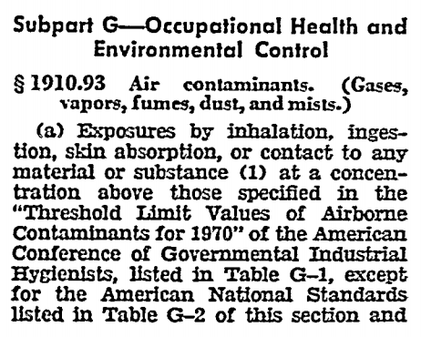
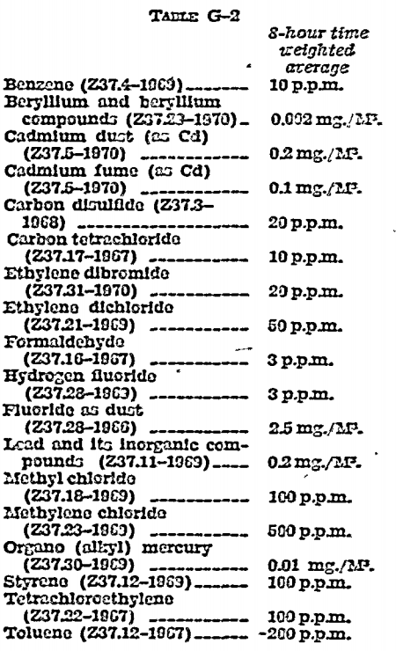
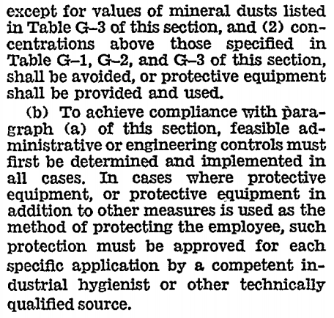
OSHA’s Incorporation of the 1969 Benzene Standard
36 Fed. Reg. 10,466 (May 29, 1971).

Slide 16
Incorporation by Reference Today
Federal policy has encouraged agencies to rely on private standards
OMB Circular A-119
National Technology Transfer and Advancement Act of 1995 (NTTAA)
The Code of Federal Regulations contains over 17,000 provisions “incorporated by reference” to private standards
Examples
Water sampling
Off-label uses of prescription medications
Bike helmet safety standards
Nuclear power plant operations

Slide 17
Policy Considerations with Reliance on Private Standards
Potential advantages
Lowers the costs to government of adopting standards
Takes advantage of private sector’s technical expertise
Promotes harmonization (government rules align with private standards)
Potential disadvantages
Limited public access to the law when incorporated standards are copyrighted
In practice, private standard setting processes may not be as open and balanced
Possible private non-delegation problem under constitutional law?

